Slide 1
Social Media Privacy Settings
How to make your profiles private, block people, and deactivate your account on Facebook
Angelica Gonzalez, Lupe Heredia, Malia Xiong

Slide 2
How to make your profile private from a computer

Slide 3
Step 1: log in to profile Step 2: go up to right hand corner and click the small icon shaped like a gear

Slide 4
Step 3: click privacy settings

Slide 5
Step 4: go to “Who can see my stuff?” and click edit

Slide 6
Step 5: change your setting from everyone to friends, or only me depending on what you want to do

Slide 7
How to make your profile private from a cell phone

Slide 8
Step 1: click the button in the top left corner with the three lines

Slide 9
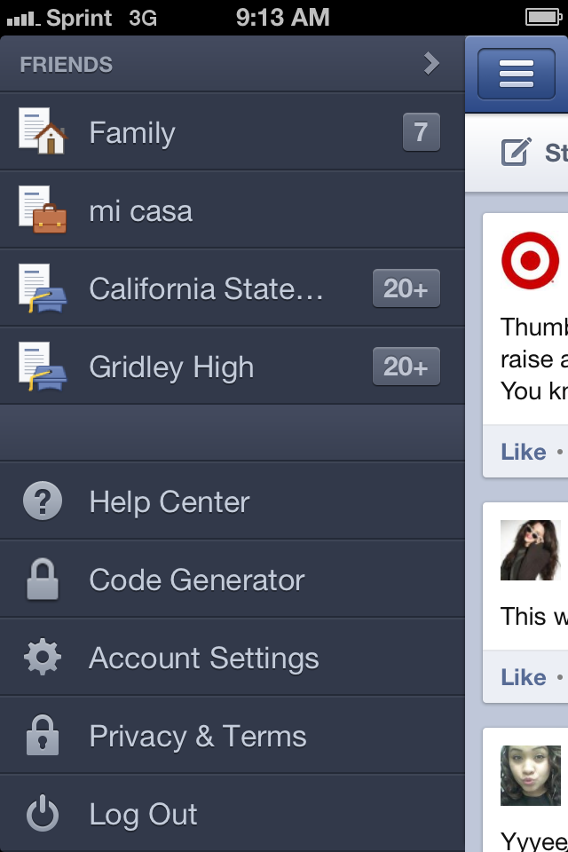
Step 2: scroll down your list all the way to privacy & terms and click it
Scroll down
To privacy settings

Slide 10
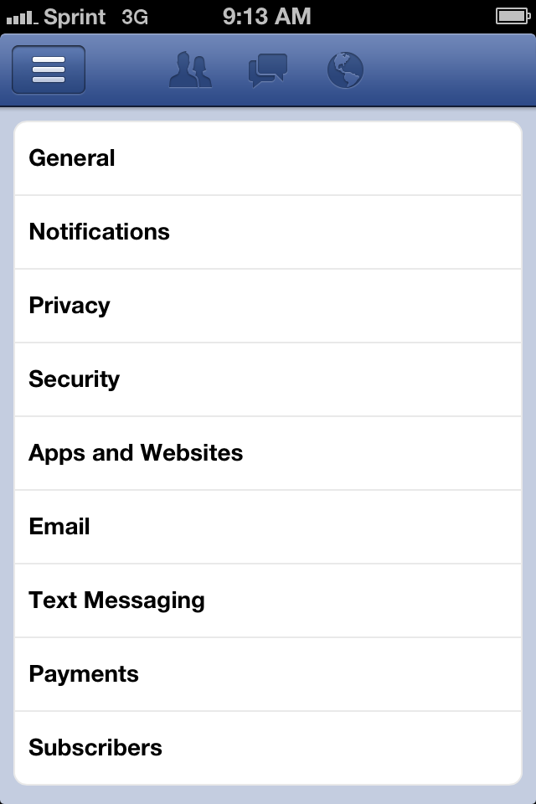
Step 3: click privacy

Slide 11
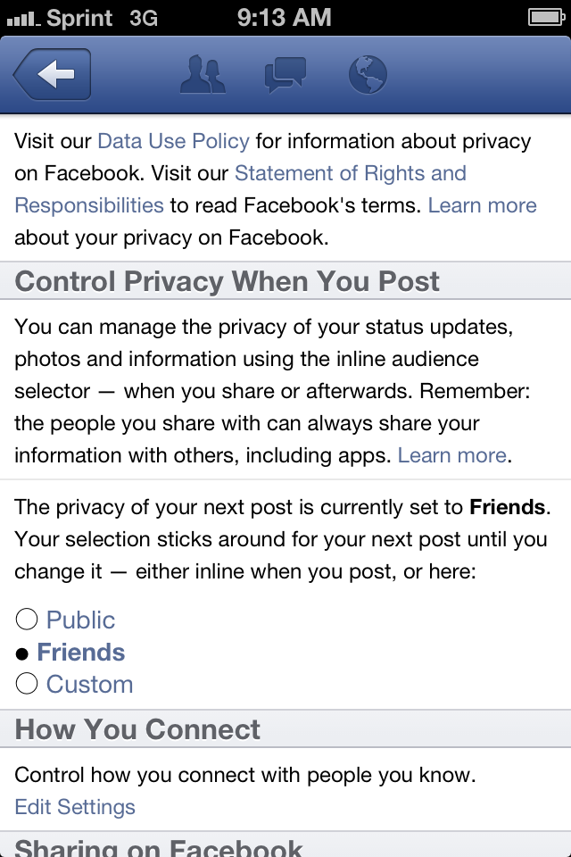
Step 4: look at “Privacy when you post.” If your setting is PUBLIC, change it to FRIENDS.

Slide 12
How to block people from a computer

Slide 13
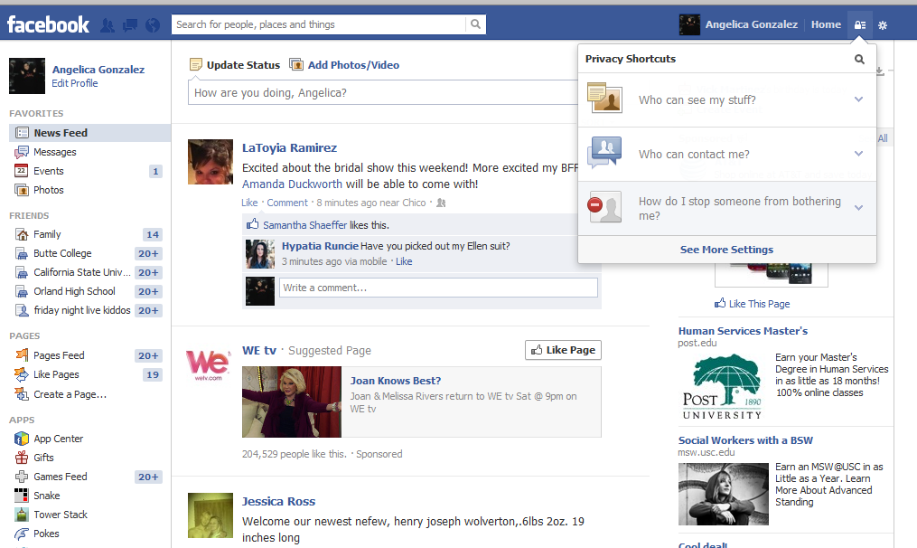
Step one: click the icon to the left of the gear in the right corner

Slide 14
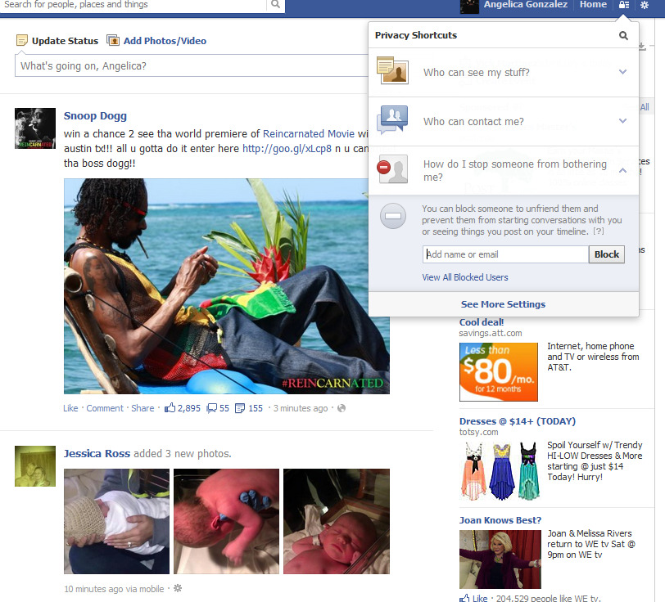
Step two: click “how do I stop someone from bothering me? Then add the email or name of person in box

Slide 15
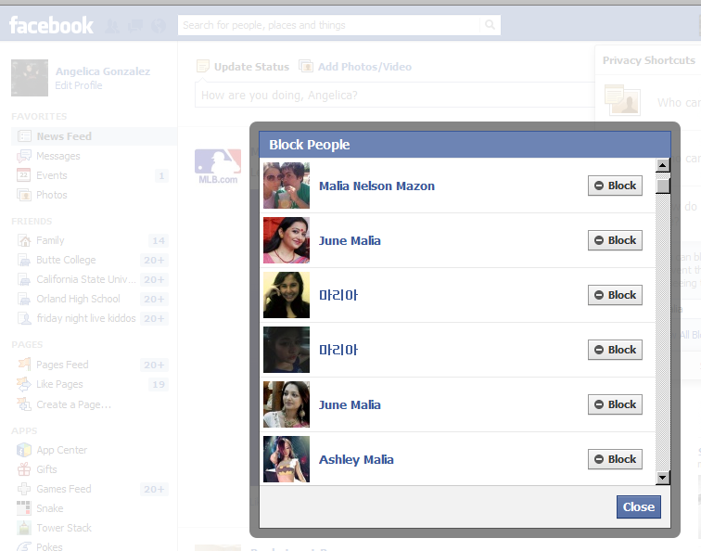
Step four: click the person you would like to block and press close.

Slide 16
How to block people from your cell phone

Slide 17
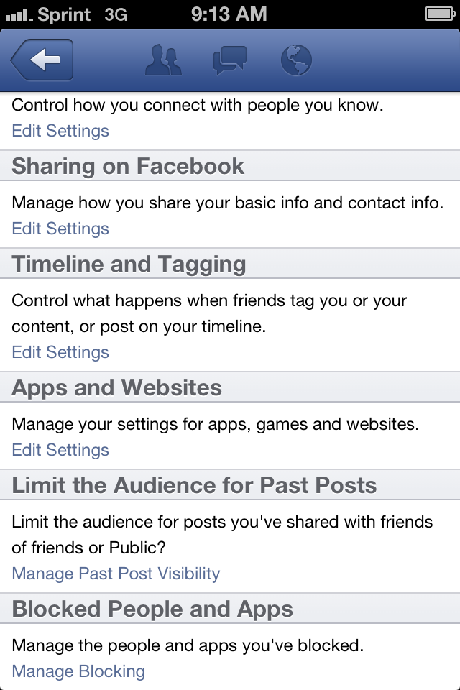
TO BLOCK PEOPLE, continue to scroll down the privacy list until you get down to “Block people and apps” then you can manage who you want to block from viewing your comments and profile

Slide 18
How to deactivate your account from a computer

Slide 19
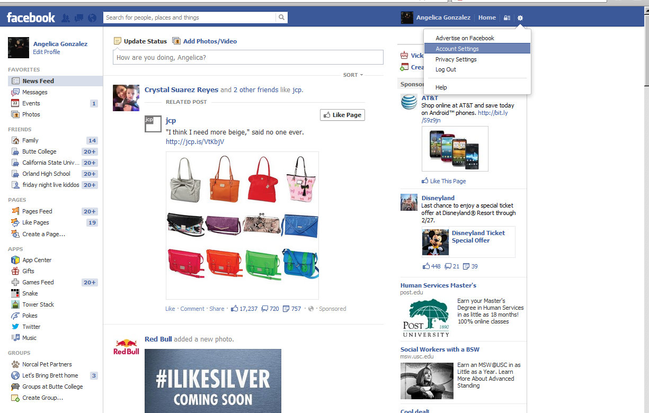
1. click the gear icon in top right corner and click account settings

Slide 20
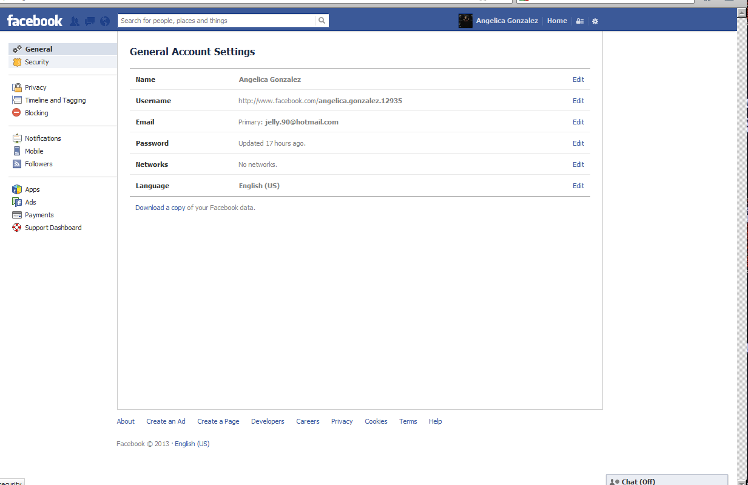
2. Click security in the left-hand column

Slide 21
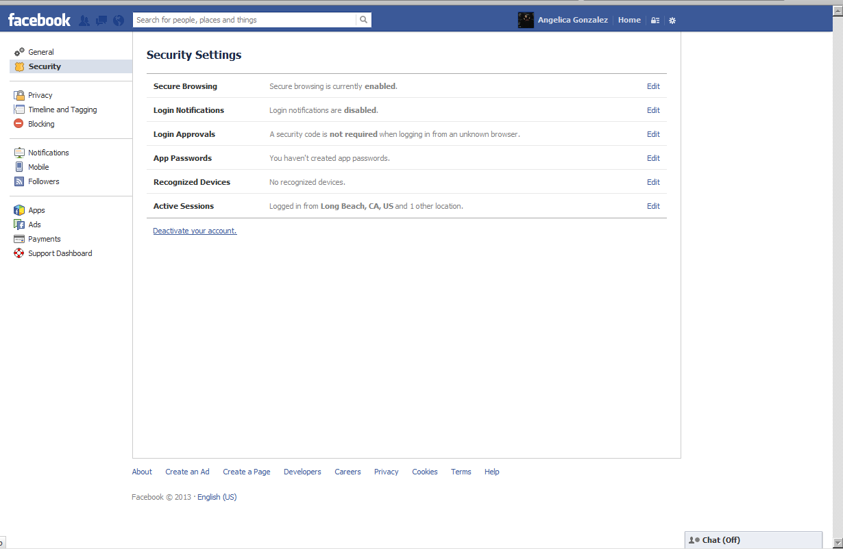
3. Click deactivate your account

Slide 22
How to deactivate your account from a cell phone

Slide 23
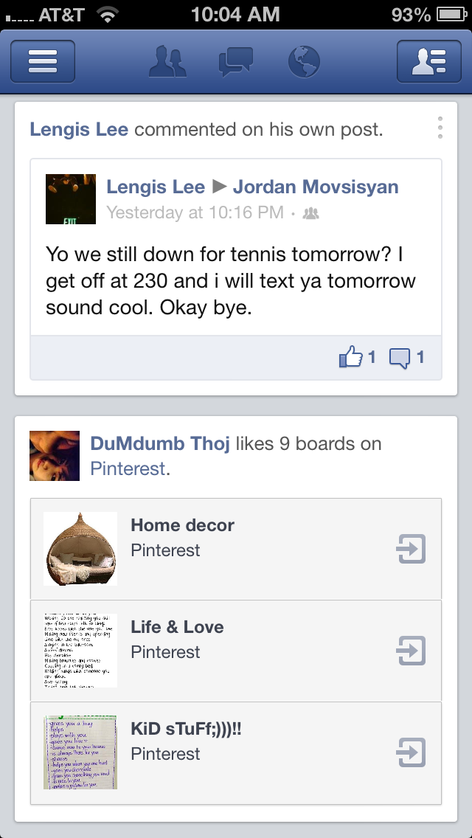
Step one: click the button in the top left corner with the three lines

Slide 24
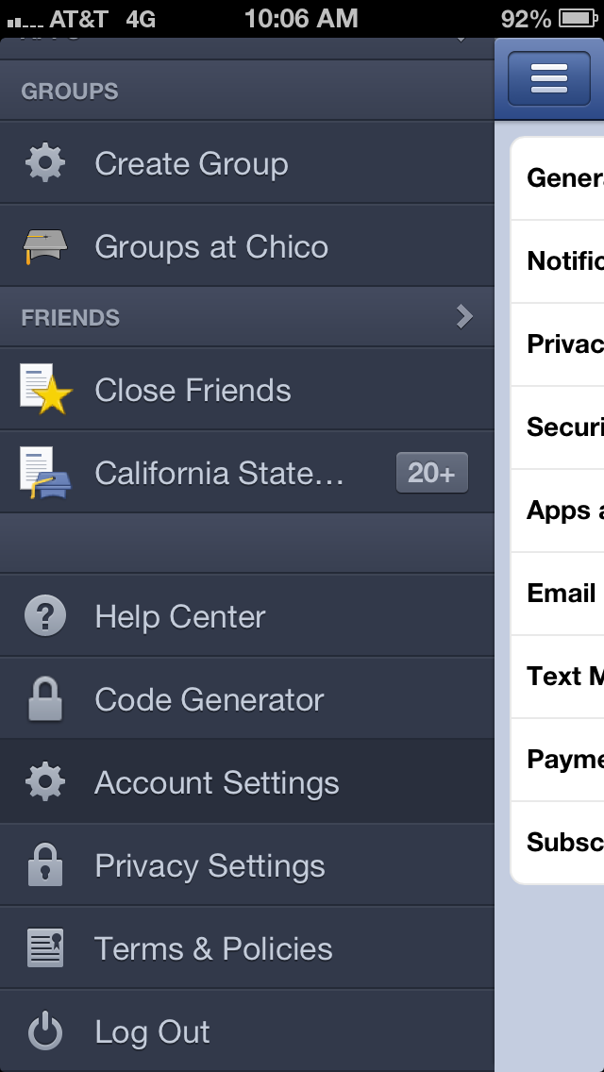
Step two: scroll down to account settings and click it

Slide 25
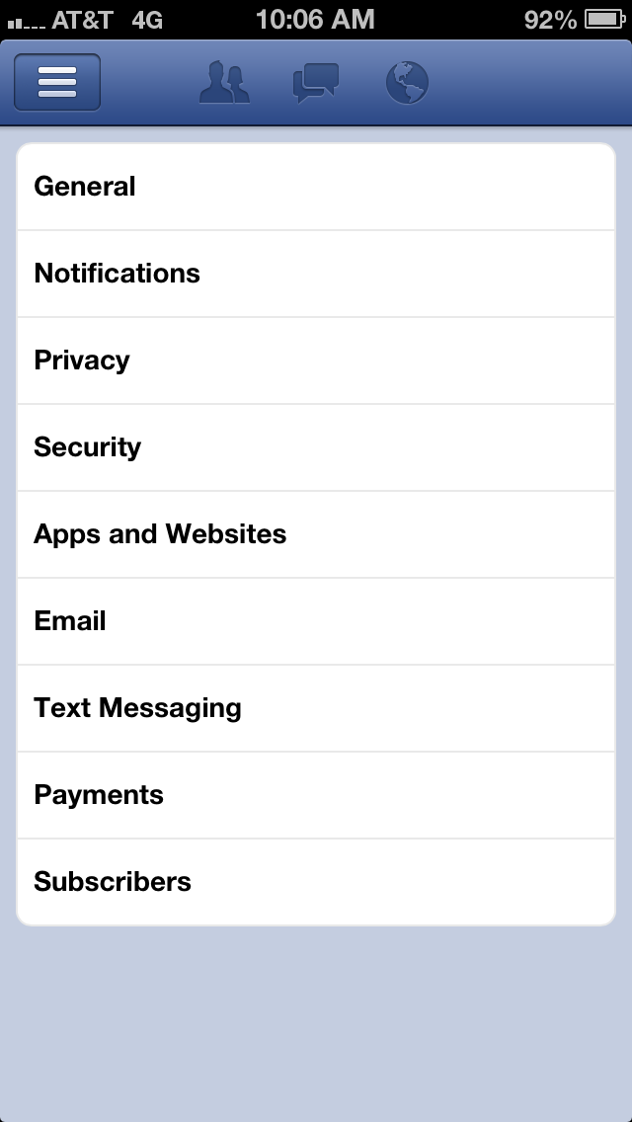
Step three: click the word general

Slide 26
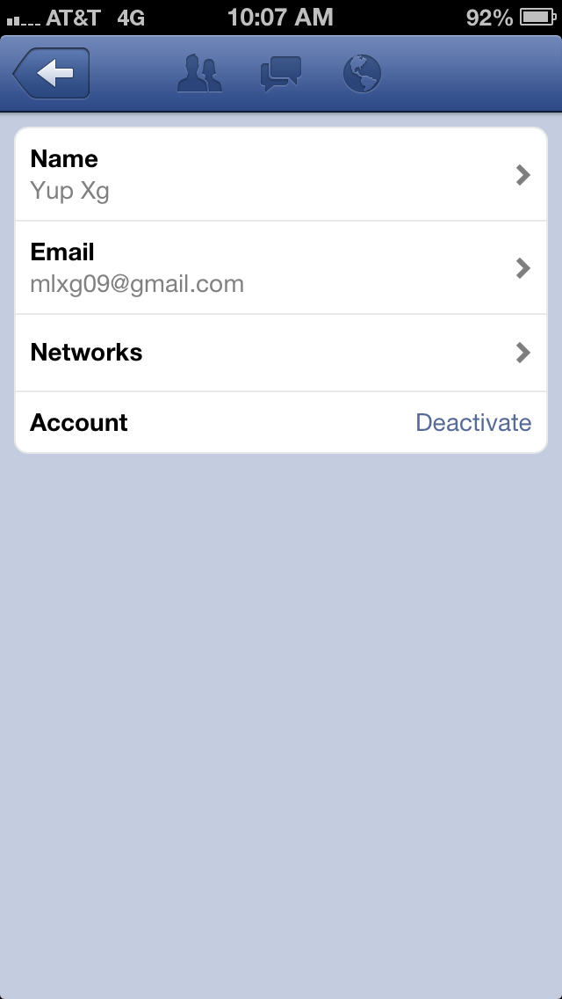
Step four: click deactivate account

Slide 27
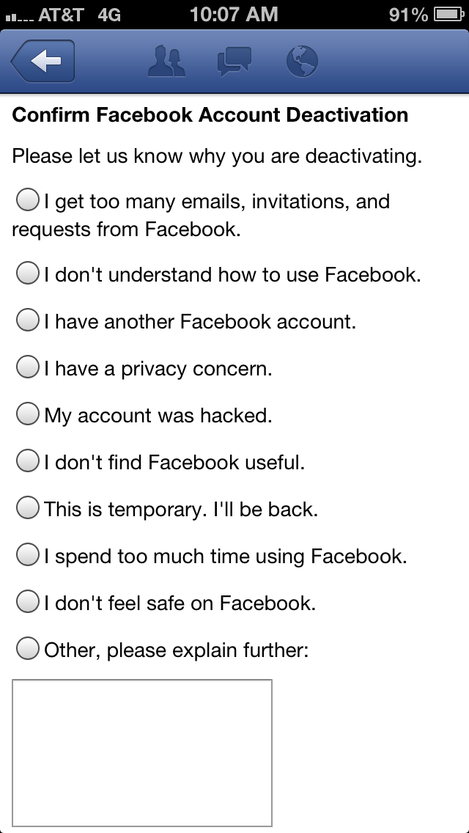
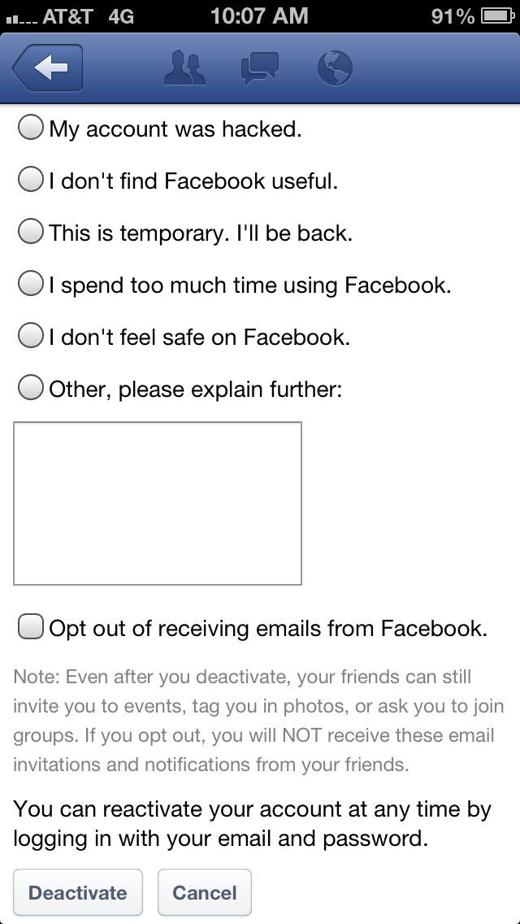
Step five: choose a reason why you are deactivating account. After this, click deactivate.

